Slide 1
Construct Convex Hull in 3-Dimensional space
Tianying Tina Zhang
tz1416@nyu.edu
With algorithms and visualization

Slide 2
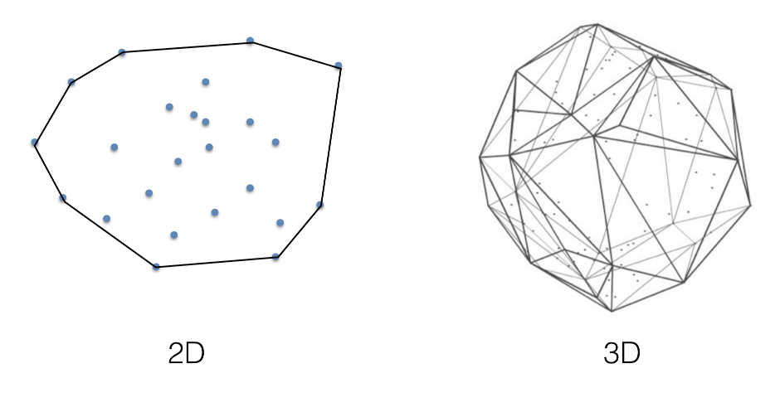

Slide 3
Project goal
Native: Brute Force
Incremental Construction: Simple Incremental Construction Advanced Incremental Construction
QuickHull
Gift Wrapping
Fully implement different algorithms by myself from blank to construct convex hulls in 3d space and visualize them.

Slide 4
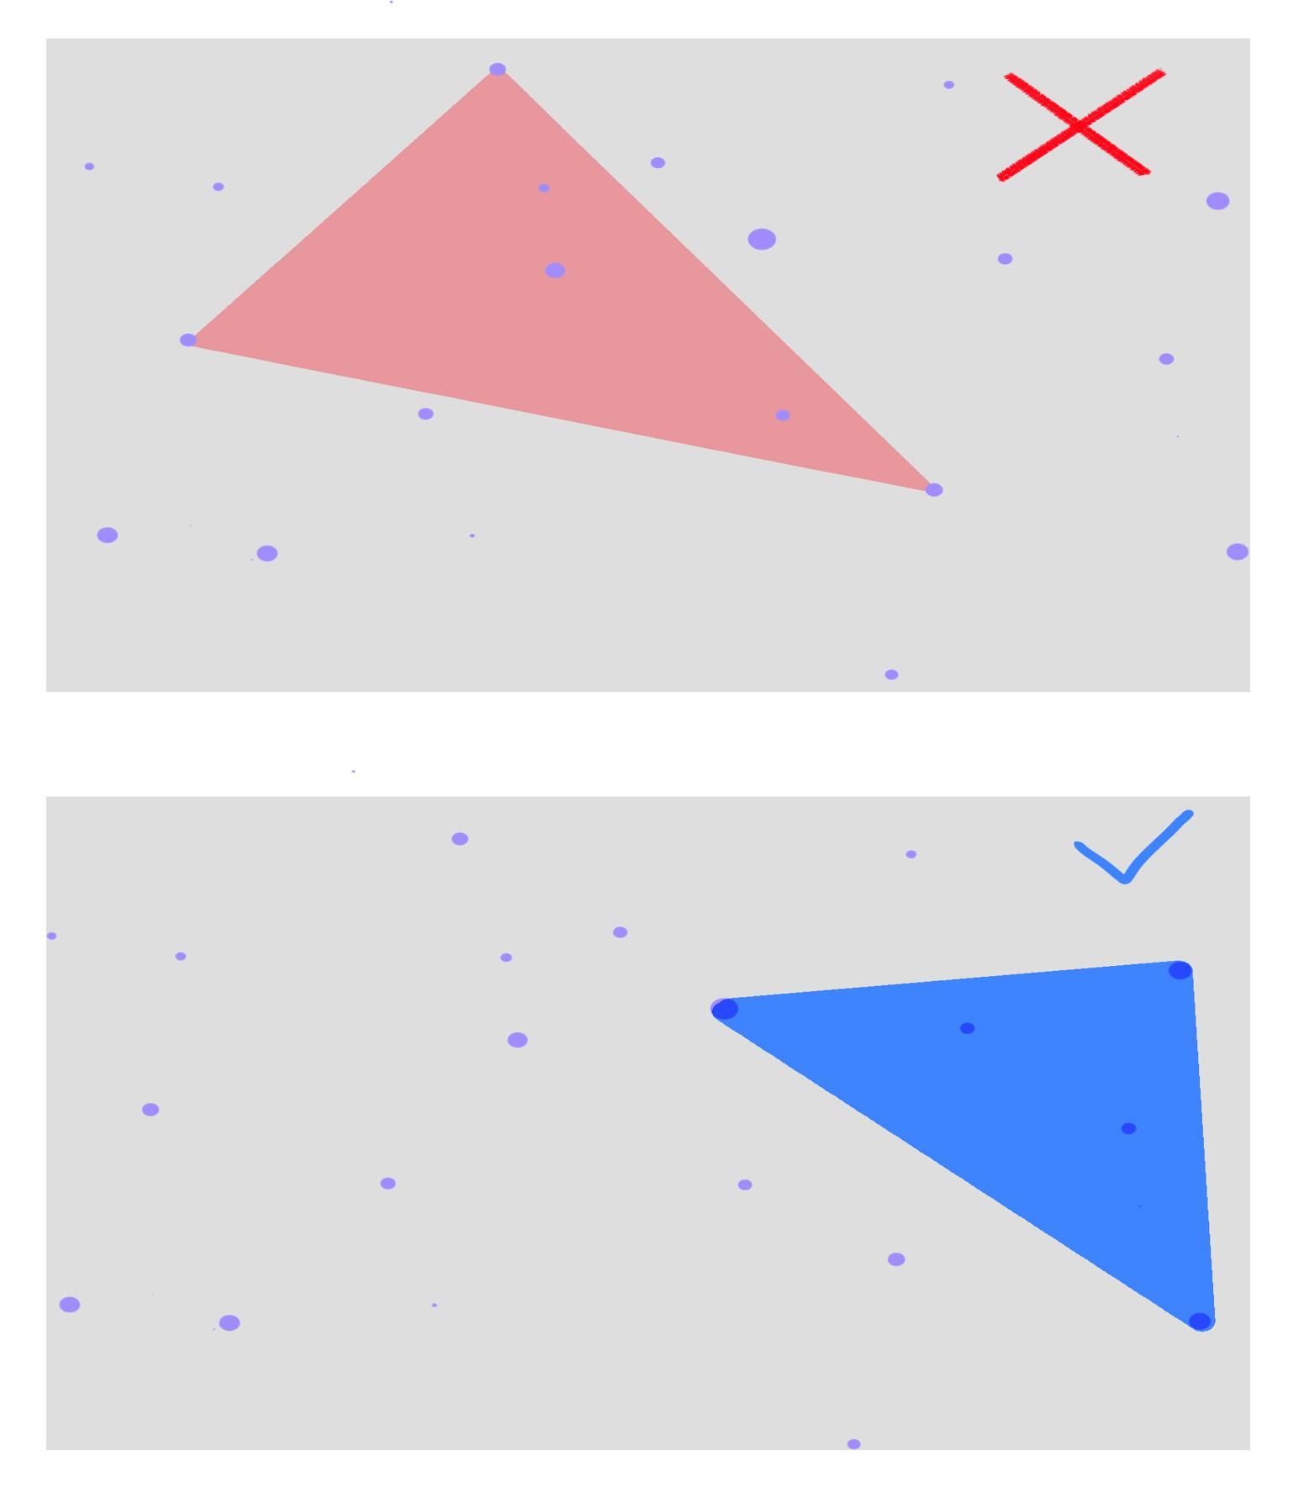
Native: Brute Force
Time Complexity:
O(n^4)
Data Structure:
An array to store the points.
An array to store the correct convex hull triangles/faces.

Slide 5
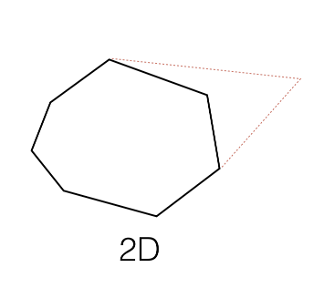
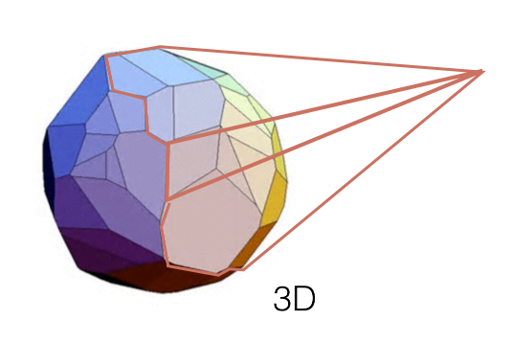
Incremental Construction(1)
Construct the initial tetrahedron
Add each vertex incrementally
Time Complexity:
O(n^2)
Data Structure:
An array to store the points.
An array to store the correct convex hull triangles/faces.
An 2D array to store the edges.

Slide 6
Incremental Construction(2)
Construct the initial tetrahedron
Add each vertex incrementally.
Run DFS to find all of the faces.
Time Complexity:
O(n^2)
Data Structure:
An array to store the points.
An array to store the correct convex hull triangles/faces.
An 2D array to store the edges

Slide 7
Quick HUll(not REAL) but better than before
Construct the initial tetrahedron: construct a face that dividing the points in two halves P1 and P2. And continuously find the farthest points for the two sides of the face.
Add each vertex incrementally.
Run DFS to find all of the faces. This is not a good way to implement this but for small size of points, it still works.
Time Complexity:
O(n^2) but if a real quickhull can be O(nlogn).
Data Structure:
An array to store the points.
An array to store the correct convex hull triangles/faces.
An 2D array to store the edges
I met problem on merging the polygons so after initialize the first triangle face, I still use the dfs way. In the algorithm side, it seems nothing improved, but in the visualization side, it saves a lot of rendering process.

Slide 8
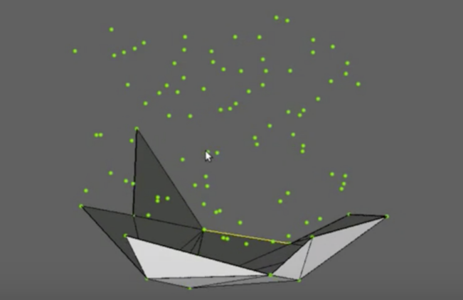
Gift wRAPPING
Find the first face on the convex hull
"Wrap" gift
Time Complexity:
O(n^F)
Data Structure:
An array to store the points.
An array to store the correct convex hull triangles/faces.
A queue to store the triangles which needed to be wrapped/not entirely closed.

Slide 9
Citations
Mark de Berg, Otfried Cheong, Marc van Kreveld, and Mark Overmars. 2008. Computational Geometry: Algorithms and Applications (3rd ed.). Springer-Verlag TELOS, Santa Clara, CA, USA.
Gregorius, Dirk. Implementing QuickHull, 2014, media.steampowered.com/apps/valve/2014/DirkGregorius_ImplementingQuickHull.pdf

Slide 10
Thank you!

